Slide 1

SIDDHARTH INSTITUTE OF ENGINEERING & TECHNOLOGY
(AUTONOMOUS)
(Approved by AICTE, New Delhi & Affiliated to JNTUA, Ananthapuramu)
(Accredited by NBA for Civil, EEE, Mech., ECE & CSE
Accredited by NAAC with ‘A+’ Grade)
Puttur -517583,Tirupathi District, A.P. (India)
DEPARTMENT OF COMPUTER SCIENCE AND ENGINEERING
CSE (ARTIFICIAL INTELLIGENCE AND MACHINE LEARNING
Academic Year 2025-26
Project Second Review
Title of Project
Towards Green and Trustworthy 6G:Federated Learning Approaches for Robust Privacy.
Batch Details
S.NO: | REG NO | NAME | INTERNAL GUIDE
1 | 22F61A3114 | C S MADESH | K EZHILARASI M.Tech Assistant Professor
2 | 22F61A3119 | D MOUNIKA
3 | 23F65A3101 | K ADIMURTHY
4 | 23F65A3106 | T VIJENDRA

Slide 2
OBJECTIVE
The objective of this project is to design and implement a privacy-preserving, decentralized machine learning system tailored specifically for the demanding environment of 6G networks.
With the help of Federated Learning (FL), the system enables multiple edge devices to collaboratively train machine learning models without sharing their raw data, thereby preserving user privacy and reducing network congestion.
The project involves developing a secure and interactive web application using Flask, where users can register, upload beamforming datasets, select from multiple machine learning algorithms, and receive real-time prediction results. The backend simulates FL rounds by averaging encrypted model weight updates from virtual edge clients.
Ultimately, the system demonstrates the feasibility and benefits of Federated Learning for future 6G-enabled intelligent infrastructure.

Slide 3
ABSTRACT
The next generation of wireless communication, 6G, is expected to interconnect billions of ultra‑intelligent devices and deliver sub‑millisecond latency for immersive applications such as holographic telepresence and autonomous mobility.
Traditional cloud‑centric AI pipelines cannot scale to this setting because continuous raw‑data transfer overloads backhaul links and exposes sensitive user information.To address this gap, our project implements a federated‑learning (FL) framework in which edge devices train models locally and share only encrypted weight updates with a coordinating server.
We prototype the concept in a Flask web application that allows users to register, upload sample beamforming datasets, choose among six candidate algorithms (Random Forest, FNN, CNN, MLP, XGBoost, Decision Tree), and receive real‑time prediction feedback on 6G beam‑forming success.

Slide 4
LITERATURE REVIEW
Title of the Paper | Authors | Year | Implications
Blockchain empowered Federated Learning for 6G. | Xu et al. | 2023 | Combine FL with blockchain for traceability and trust in 6G; emphasizes audit trails and secure updates.
Federated Learning for Edge Intelligence in 6G Networks. | Yang et al. | 2022 | Overview of enabling FL in 6G, covers latency, non-IID issues, and model convergence.
Federated Learning in 6G: A Survey on Enabling Technologies. | Luong et al. | 2021 | In-depth survey on FL challenges and architectures in 6G ecosystems.

Slide 5
Literature Review
Title of the Paper | Authors | Year | Implications
Adaptive Federated Learning in Resource Constrained Edge Systems. | Wang et al. | 2021 | Proposes adaptive scheduling strategies to handle client heterogeneity and stragglers
Practical Secure Aggregation for Privacy-Preserving ML. | Bonawitz et al. | 2021 | Introduces secure aggregation protocols enabling privacy-preserving global model updates.
Federated Learning for Edge Intelligence: Applications and Challenges | Zhang et al. | 2021 | Highlights edge-based FL deployment, communication savings, and scalability.

Slide 6
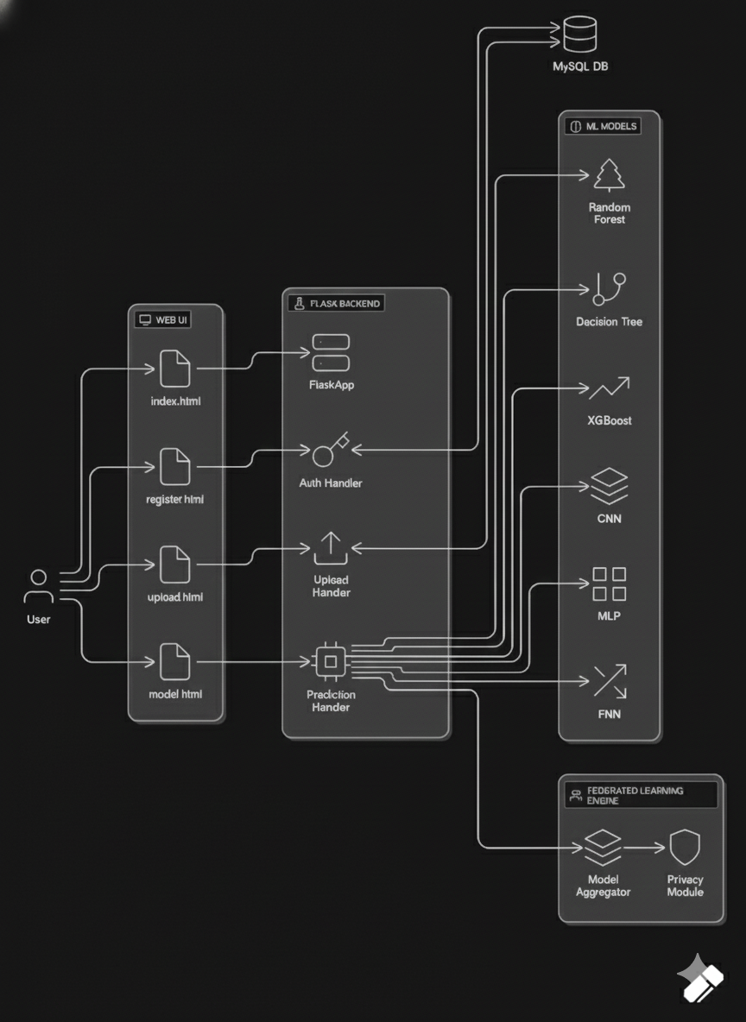
ARCHITECTURE DIAGRAM

Slide 7
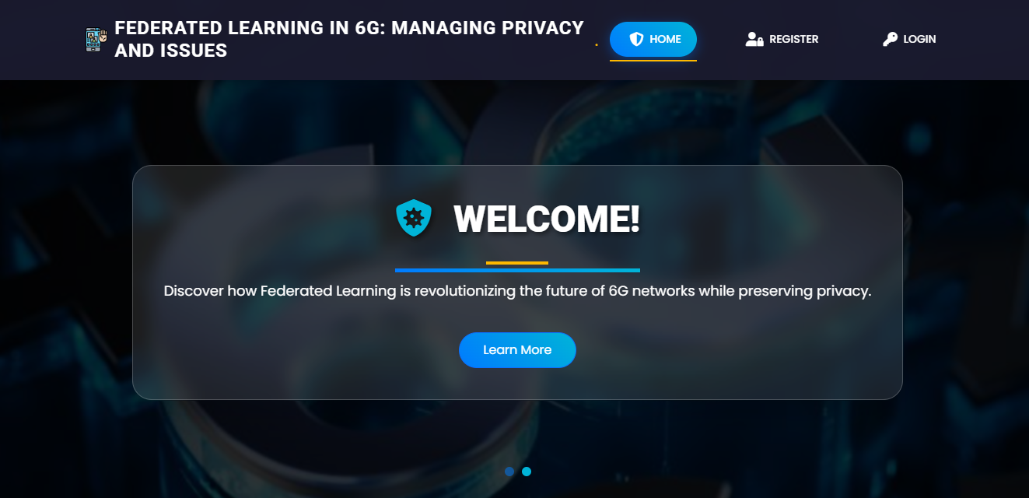
MODULES
Home Page:The HomePage serves as the landing page of your application. It provides an overview of the project's features, objectives, and benefits. Users can navigate to other sections of the application from this page.

Slide 8
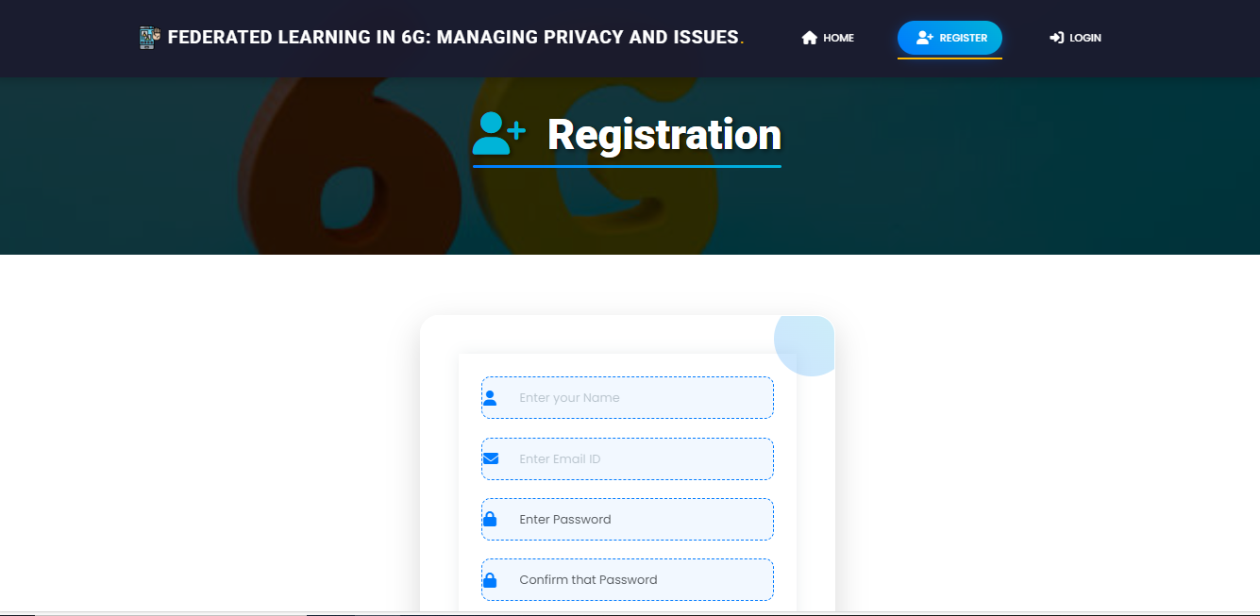
Registration Page: The Registration Page allows new users to create an account with the application. It typically includes fields for entering personal information such as name, email,password, and possibly other details like phone number or address. Users need to fill out this form to gain access to the application's features.

Slide 9
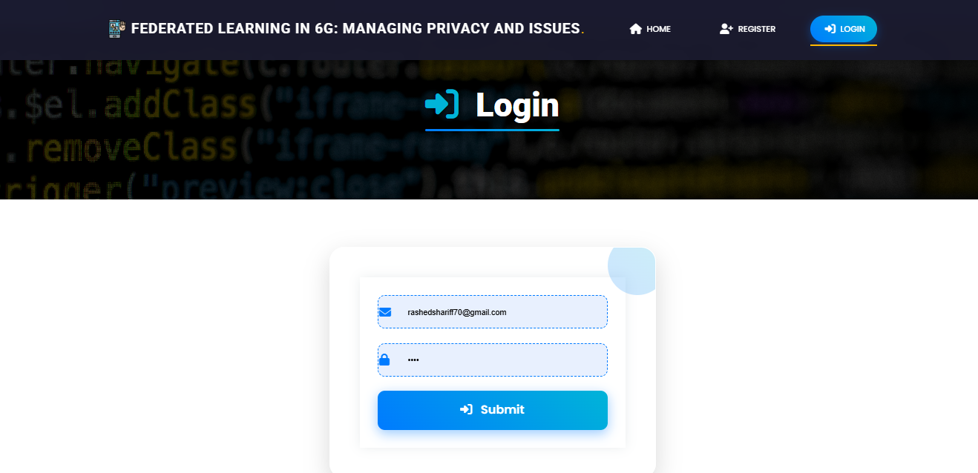
Login: The login page allows registered users to securely access the application. User have to provide register email and password.

Slide 10
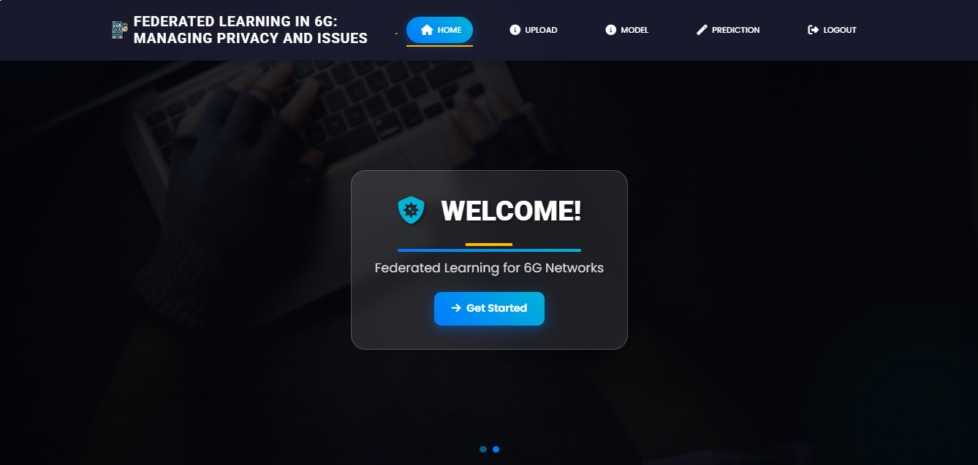
Home page after login

Slide 11
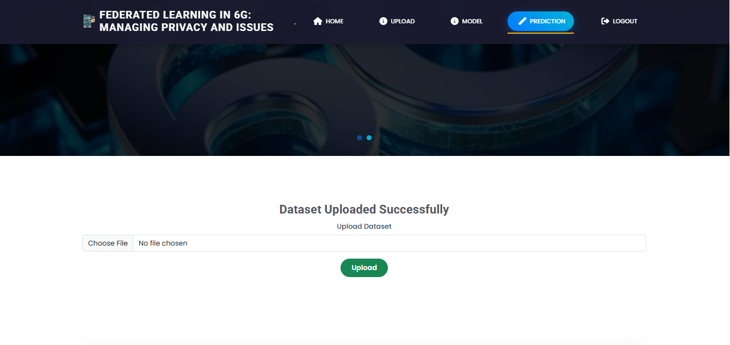
Upload: Here you can upload the dataset and view the dataset

Slide 12
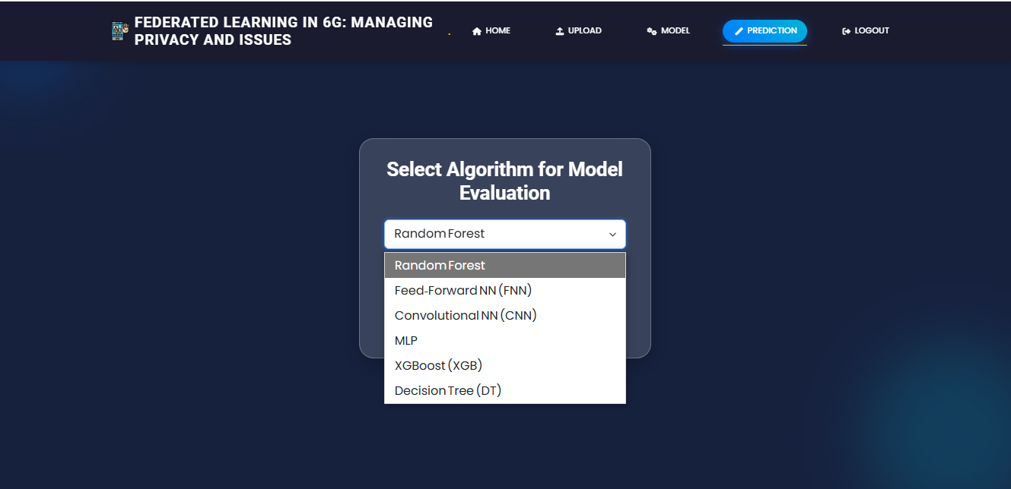
Model Selection: Here user have to select the model and email, password view the accuracy so that we know which algorithm is giving the highest accuracy.

Slide 13
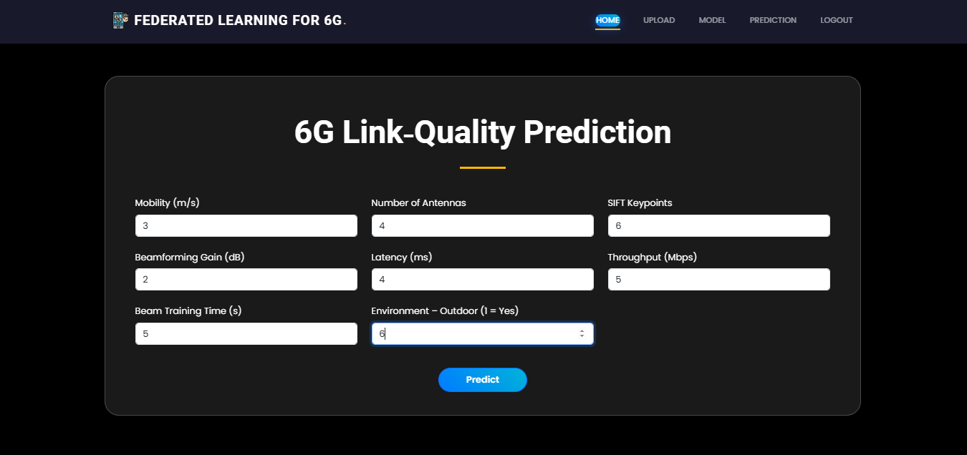
Prediction: This is the prediction page here user have to provide values of a 20 features and our model is predict the final output.

Slide 14
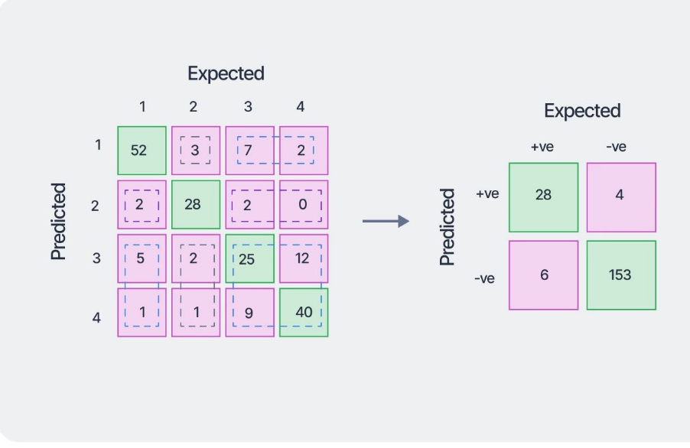
RESULT EVALUATION
Prediction Outcome
Models classified beamforming results as Success or Failure
Evaluation performed under simulated federated learning rounds
No raw data shared; only model parameters aggregated
Performance Results
Decision Tree, Random Forest, XGBoost
→ 100% accuracy in predicting Success/Failure
FNN, CNN, MLP
→ High accuracy with minor misclassification
Confusion Matrix Insight
Tree-based models showed:
  Zero false positives
  Zero false negatives
Indicates perfect beamforming decision reliability
Federated Learning Impact
✔ Preserved data privacy
✔ Reduced communication overhead
✔ Maintained centralized-model-level accuracy

Slide 15
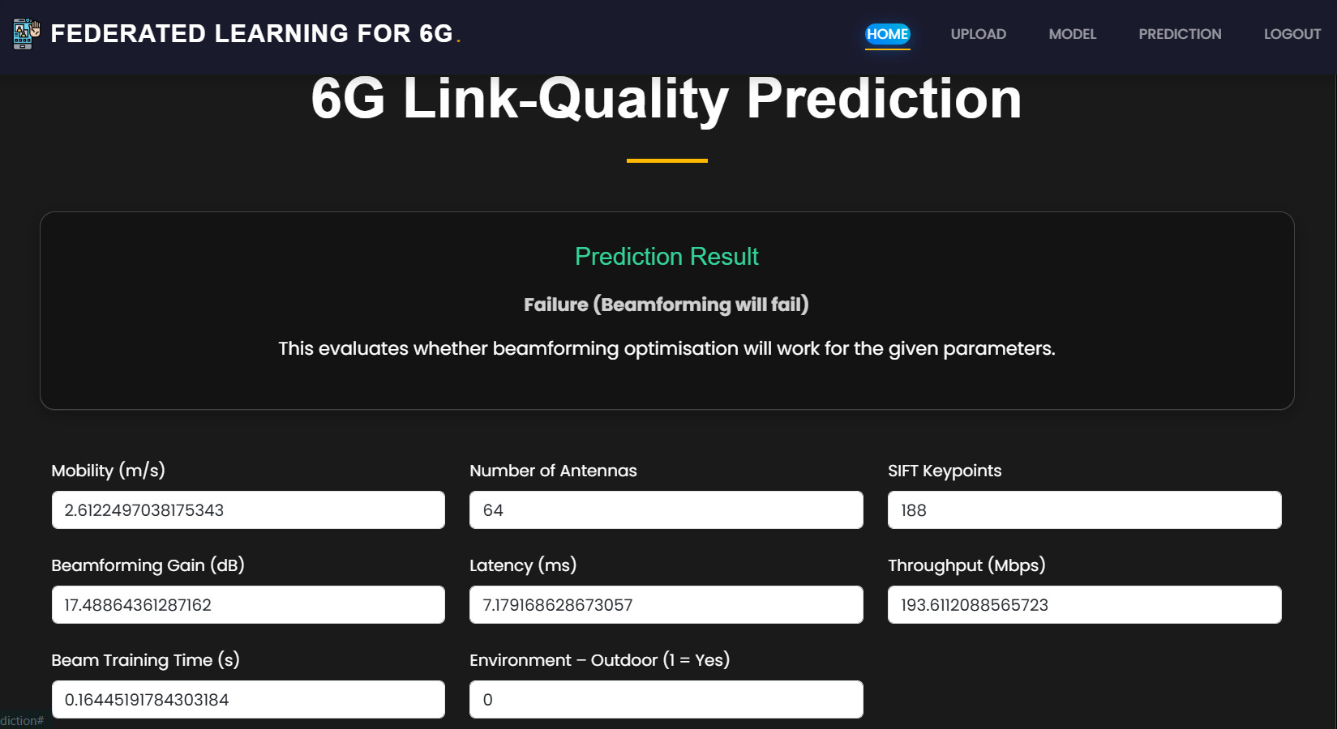
Result :After prediction show whether the beamforming will success or failure.

Slide 16
CONCLUSION
This project proposes a privacy-preserving federated learning framework to predict 6G beamforming success or failure. Traditional cloud-based ML systems face latency, scalability, and privacy issues, making them unsuitable for future 6G applications like autonomous mobility and holographic communication.
Our system uses Federated Learning, where edge devices train models locally and share only model parameters, ensuring data privacy. The framework is implemented using Python Flask with features such as secure authentication, dataset upload, model selection, and real-time prediction.
Six ML models are supported: Random Forest, XGBoost, FNN, CNN, MLP, and Decision Tree.
Tree-based models achieved 100% accuracy in simulations, proving their effectiveness for beamforming classification

Slide 17
REFERENCES
McMahan, B., Moore, E., Ramage, D., Hampson, S., & y Arcas, B. A. (2017). Communication-Efficient Learning of Deep Networks from Decentralized Data. Proceedings of the 20th International Conference on Artificial Intelligence and Statistics (AISTATS), PMLR. https://arxiv.org/abs/1602.05629
• Kairouz, P., McMahan, H. B., et al. (2021). Advances and Open Problems in Federated Learning. Foundations and Trends in Machine Learning, 14(1–2), 1–210. https://doi.org/10.1561/2200000083
• Zhu, H., Liu, Y., Zhou, Z., & Zhang, Y. (2020). Toward Efficient and Privacy-Preserving Federated Deep Learning. IEEE Network, 34(5), 16–22. https://doi.org/10.1109/MNET.001.1900664
• Niknam, S., Sharma, P. K., Anpalagan, A., Choudhury, N., & Pandey, A. (2020). Federated Learning for Wireless Communications: Motivation, Opportunities, and Challenges. IEEE Communications Magazine, 58(6), 46–51. https://doi.org/10.1109/MCOM.001.1900831

